Slide 1
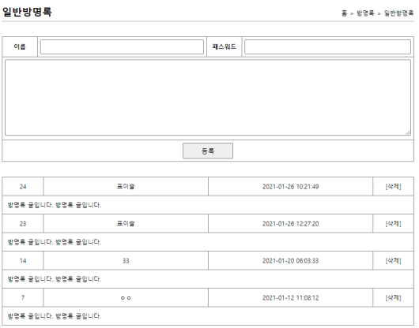

guestbook
00
사용자
jsp
controller
service
dao
sqlSession
xml
1. addList(방명록)
/guset/addList
selectList
(“guest
.guestList”)
id="guestList"
resultType
="com.javaex.vo.
GuestBookVo"
/addList(Model model)
List<GuestBookVo>
addList
List<GuestBookVo>
getGuestList
addList.jsp
포워드
guestList
guestList
guestList
guestVo
model.addAttribute("gList", guestList);
2. add(저장)
name=표이슬
password=1234
content=테스트
/guest/add?name=표이슬&password=1234&content=테스트
/guest/add
/add
(@ModelAttribute
GuestBookVo
guestBookVo)
add
(GuestBookVo
guestBookVo)
/guestInsert
(guestVo)
insert(“guest.add”
,guestVo)
id="add"
parameterType
="com.javaex.vo.
GuestBookVo"
redirect:/guest/addList
guestVo
guestVo
guestVo
guestVo
guestVo
리다이렉트
guestVo

Slide 2
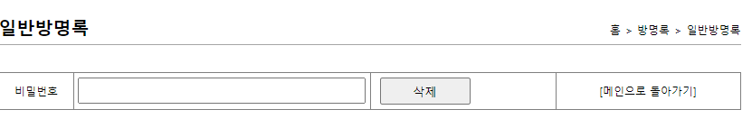
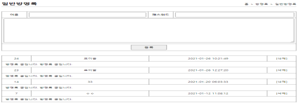
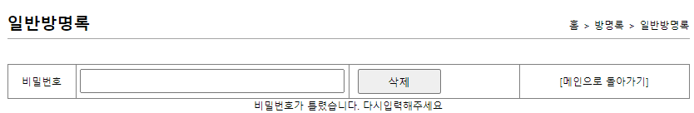
guestbook
00
사용자
jsp
controller
service
dao
sqlSession
xml
3.deleteForm(삭제폼)
addList에서 no값 가져옴
/guest/deleteForm
/deleteForm()
deleteForm.jsp
포워드
4. delete(삭제)
/guest/delete?password=1234&no=121
password=1234
no=121
guestBookVo
/guest/add
guestBookVo
guestBookVo
guestBookVo
id="delete"
parameterType
="com.javaex.vo.
GuestBookVo"
/delete
(@ModelAttribute
GuestBookVo
guestBookVo)
/delete
(GuestBookVo
guestBookVo)
/delete
(guestBookVo)
delete("guest.delete“
, guestBookVo)
redirect:/guest/addList
count
리다이렉트
count
count
count
if(count==1) //삭제 성공
else // 삭제 실패
리다이렉트
"redirect:/guest/deleteForm
?result=fail&no=" + guestBookVo.getNo();

